Slide 1
Artificial Intelligence
CS-451
Instructor: Dr. Syed Musharaf Ali

Slide 2
Course work and Evaluation
# | Module | Weight (%)
1 | Assignments/Quizzes | 20
3 | Mid Term | 20
4 | Final | 60

Slide 3
Books:
Artificial Intelligence Illuminated
By Ben Coppin
Artificial Intelligence A Modern Approach
By Stuart Russell and Peter Norvig

Slide 4
What is Artificial Intelligence ?
Artificial:
Something produced by human beings rather than occurring naturally
Intelligence:
The ability to acquire knowledge and apply skills.
Ability to figure out what do to when you do not know what to do under the given environment or scenario
Notes:
Cognitve : process of knowing, learning

Slide 5

What is Artificial Intelligence ?
The science and engineering of making intelligent machines, especially intelligent computer programs.
Artificial Intelligence is a way of making a computer, a computer-controlled robot, or a software think intelligently, in the similar manner the intelligent humans think.
Notes:
Cognitve : process of knowing, learning

Slide 6
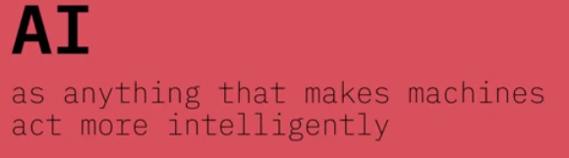
What is Artificial Intelligence ?
Notes:
Cognitve : process of knowing, learning

Slide 7
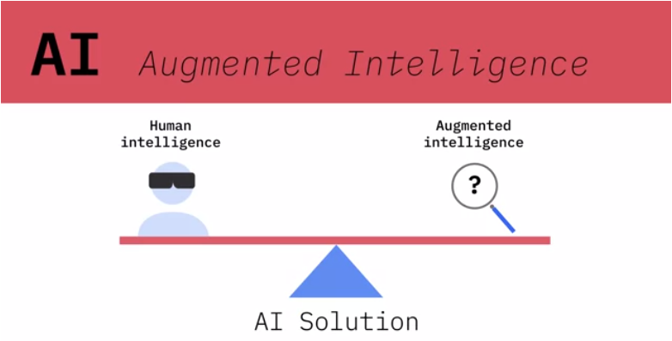
AI should not attempt to replace human experts, but rather extend human capabilities and accomplish tasks that neither humans nor machines could do on their own.
Notes:
Cognitve : process of knowing, learning

Slide 8

What is Artificial Intelligence ?
AI enhances the capabilities of domain expert
Notes:
Cognitve : process of knowing, learning

Slide 9
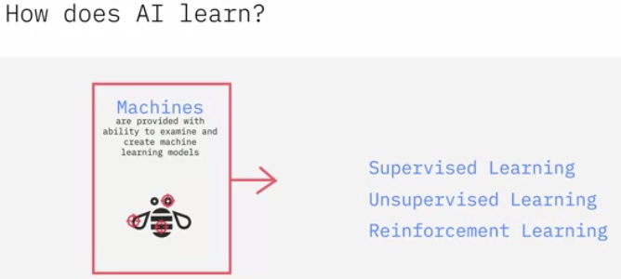
We provide machines the ability to examine examples and create machine learning models based on the inputs and desired outputs.
Notes:
Cognitve : process of knowing, learning

Slide 10
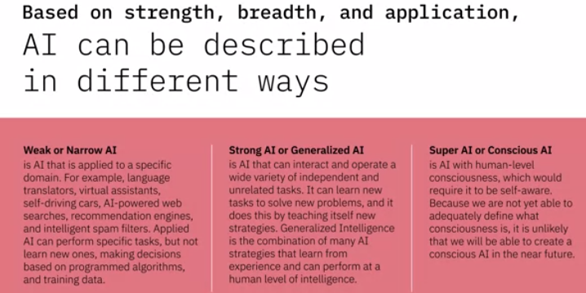
Notes:
Cognitve : process of knowing, learning

Slide 11
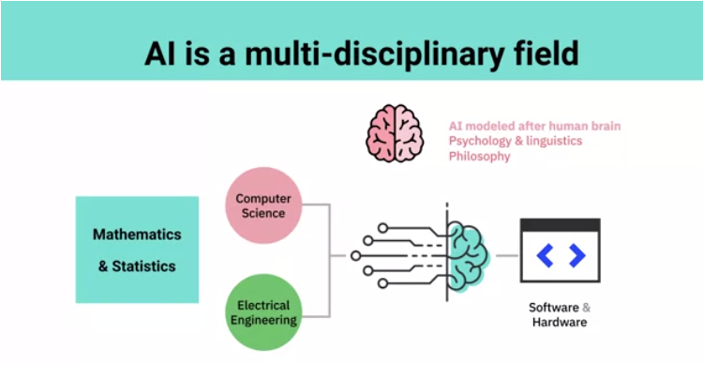
Notes:
Cognitve : process of knowing, learning

Slide 12
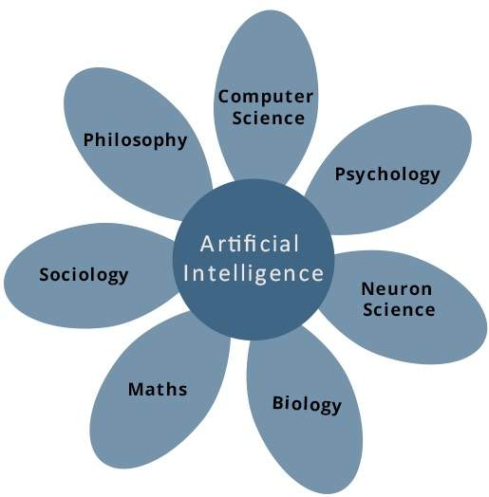
Goal of Artificial Intelligence
To integrate all acquired knowledge disciplines into one system that can understand, think, learn, and behave like humans.
Notes:
Cognitve : process of knowing, learning

Slide 13
Applications of Artificial Intelligence
Finance
Intelligent Robotics
Gaming
Medicine
Web
Natural language processing
Expert systems
Vision systems
Handwriting recognition
etc………
Notes:
Cognitve : process of knowing, learning

